Slide 1
Indigenous disaster and emergency management
Do past disasters give insight into the Covid 19 pandemic?
Simon Lambert
Indigenous Studies,
University of Saskatchewan

Slide 2
What am I going to talk about?
Who am I?
And what do I know about disasters?
Some terms and definitions
History
Indigenous Peoples and disasters
Pandemics
What’s going on in SK?
Research challenges
Questions?

Slide 3
Who am I?
Ko Panekiri te maunga
Ko Waikaremoana to roto
Ko Waikaretaheke to awa
Ko Ngai Tuhoe raua ko Ngati Ruapani nga iwi
Ko te Kuha Tarewa raua ko Waimako nga marae
Ko Lambert te whanau

Slide 4
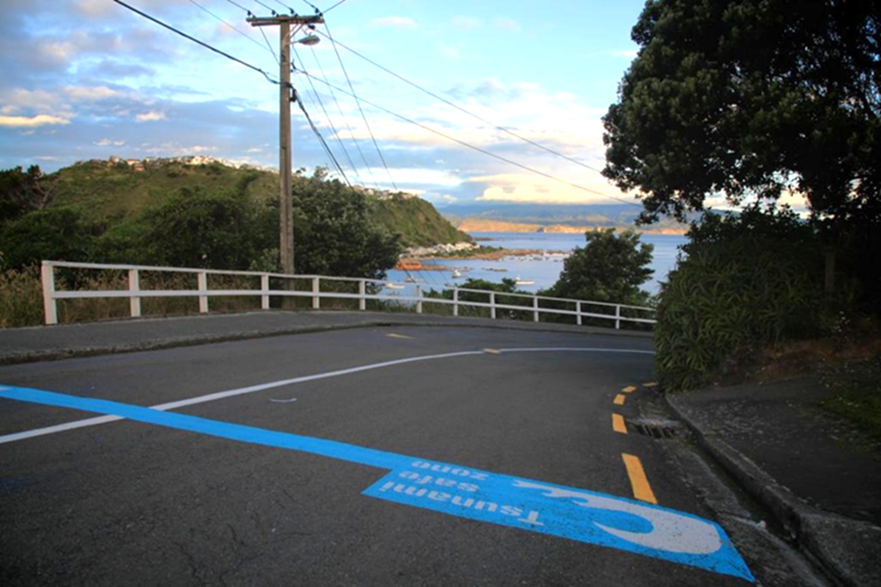
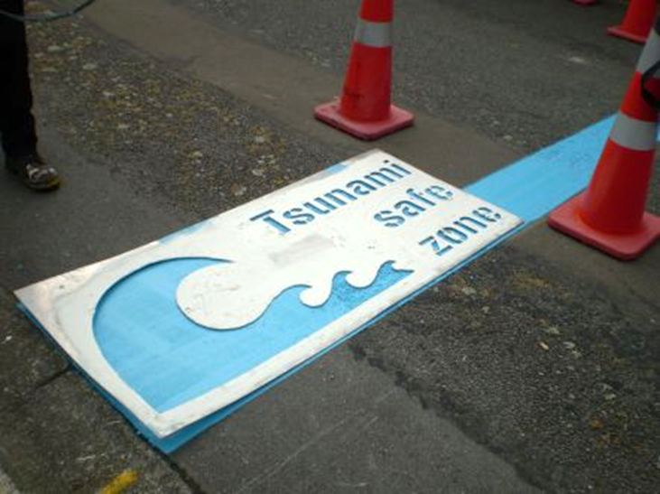
Aotearoa NZ

Slide 5
What do I know about disasters?

Slide 6
EQ research SUmmary
Māori cultural practices and institutions provided important resources in the earthquake response.
To Māori and non-Māori
Local tribe provided keystone investment and strategic vision in recovery
Economic wellbeing a significant factor in individual and family resilience.
Other hazards (e.g. CC/SLR) still challenging Māori.

Slide 7
“First the earthquake, then the disaster…”

Slide 8
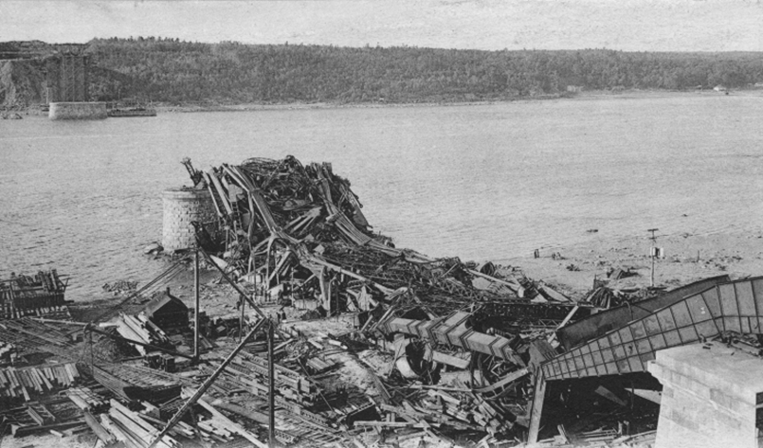
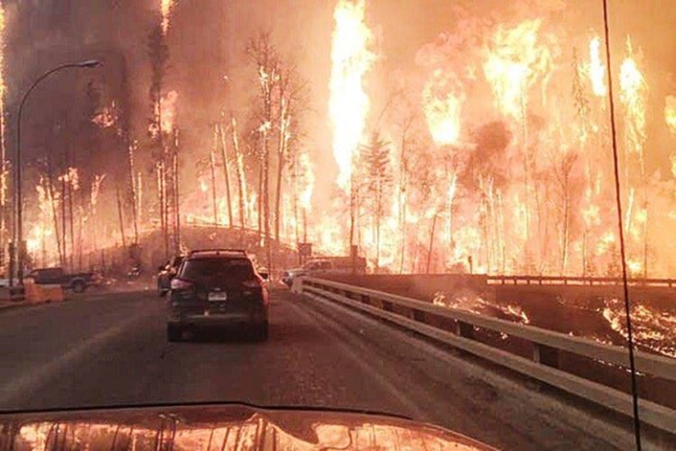
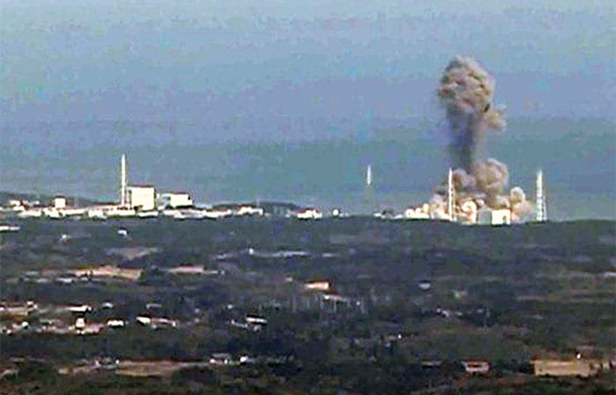
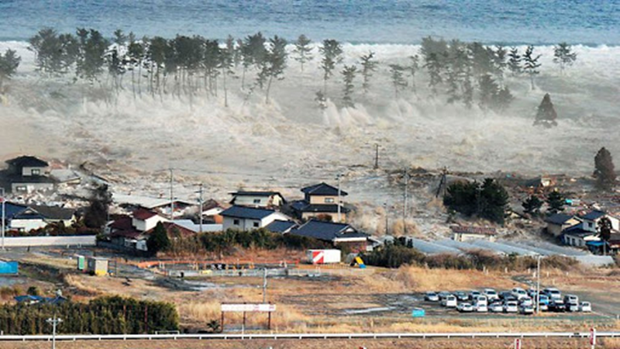
What is a Disaster?

Slide 9
What is a Disaster?
Who defines what they are, when and where they occur, and what can or should be done to reduce future risks, if anything is done at all?
Physical parameters
Social “
Cultural “
When is a disaster over?

Slide 10
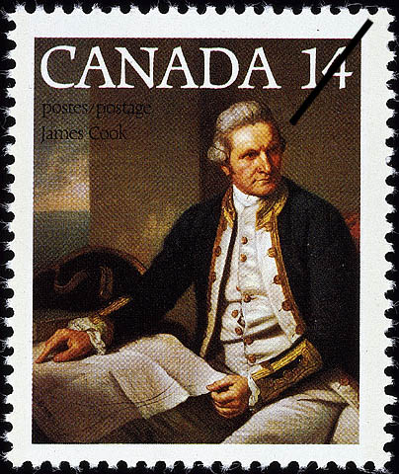
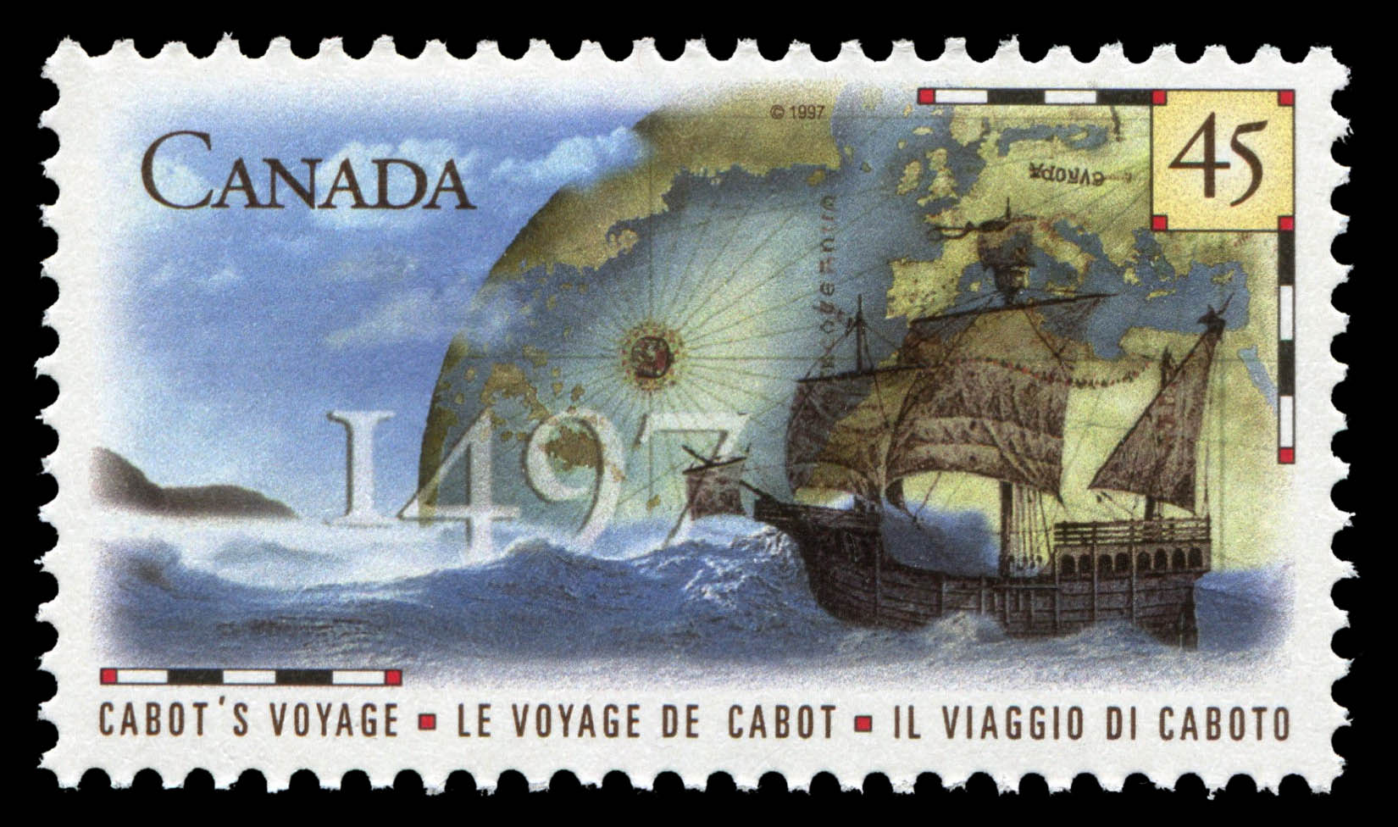
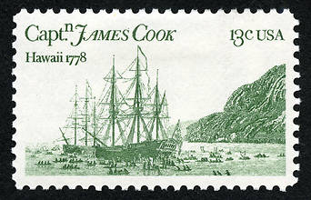
What is a Disaster?

Slide 11
Canada’s definition of Disaster…
10 or more people killed
100 or more people affected/injured/infected/evacuated or homeless
an appeal for national/international assistance
historical significance
significant damage/interruption of normal processes such that the community affected cannot recover on its own
(Public Safety Canada, 2017)

Slide 12
Canada’s definition of Disaster…
10 or more people killed
100 or more people affected/injured/infected/evacuated or homeless
an appeal for national/international assistance
historical significance
significant damage/interruption of normal processes such that the community affected cannot recover on its own
(Public Safety Canada, 2017)

Slide 13
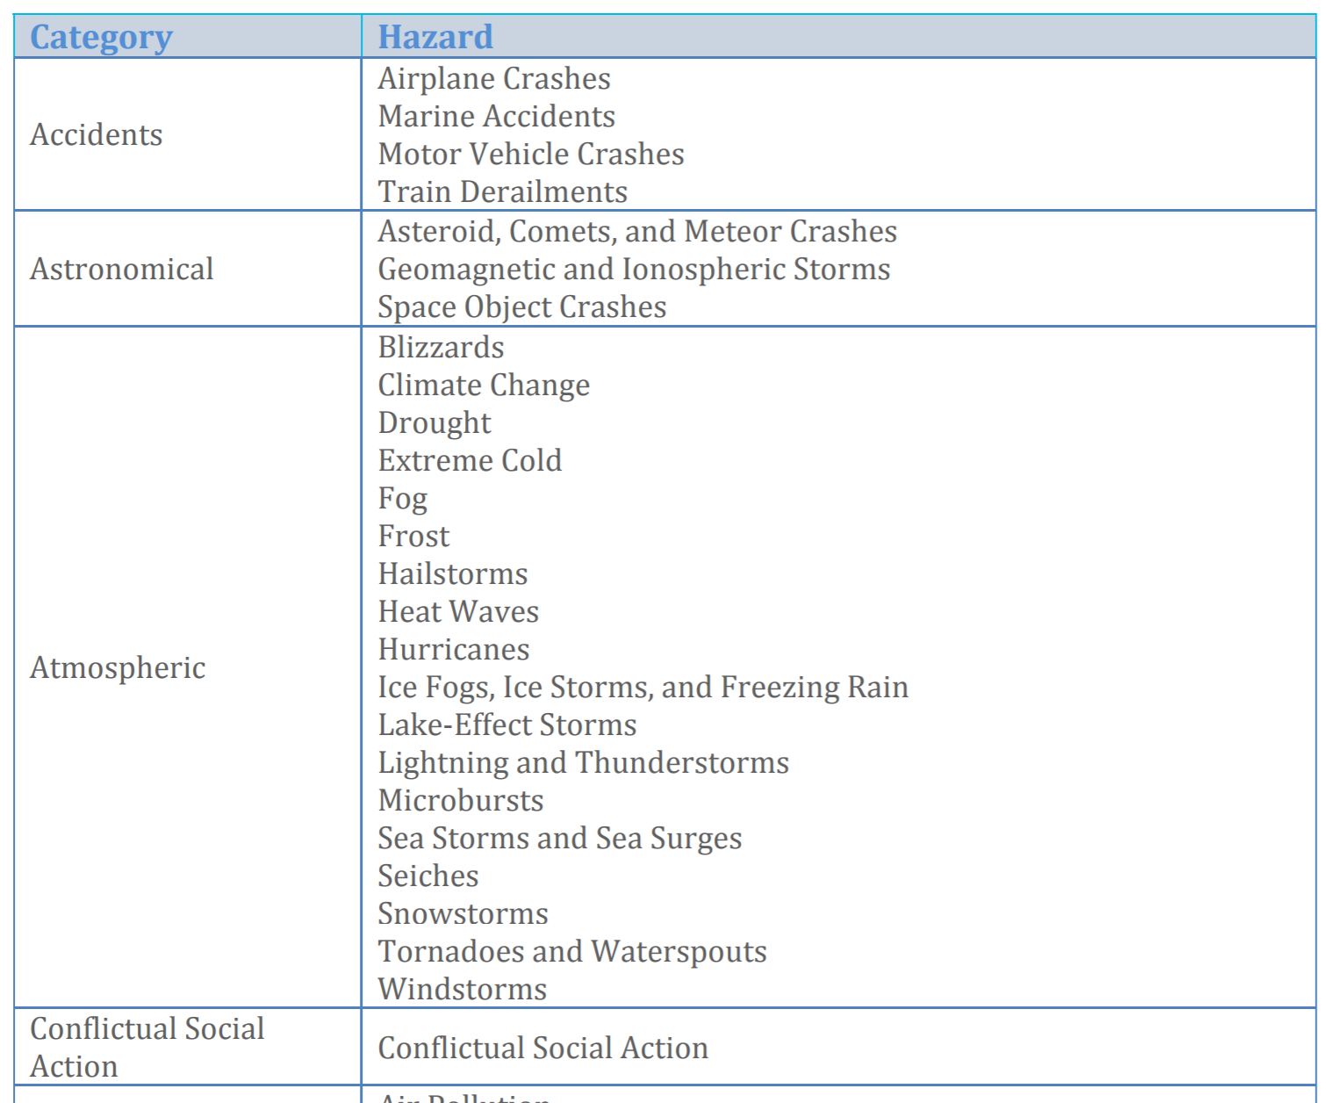
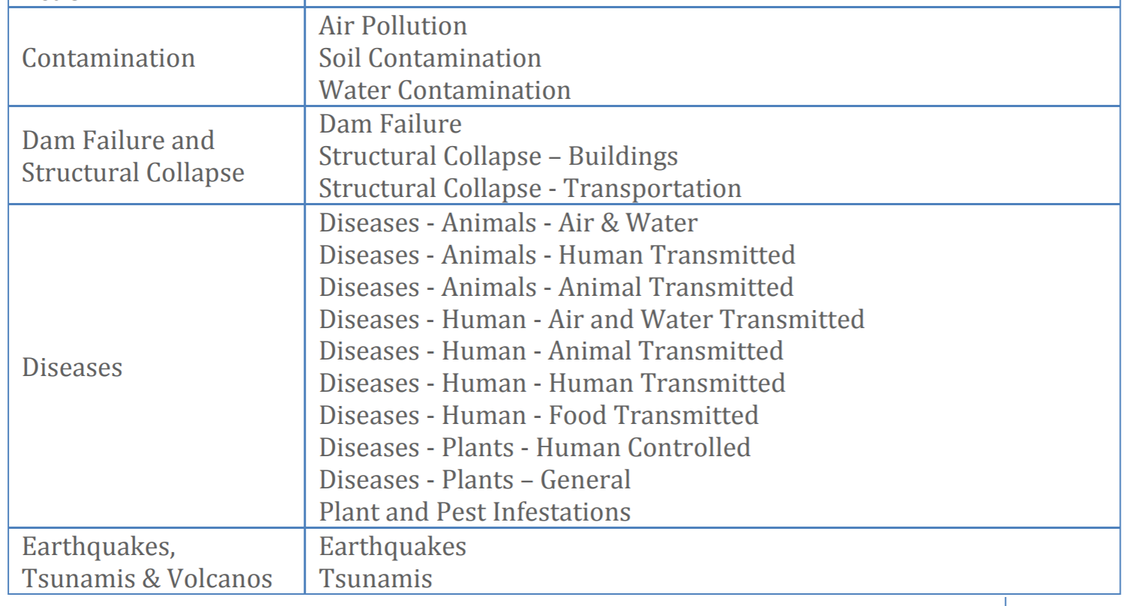
Hazards
Notes:
Source: Aboriginal Disaster Resilience Planning (Justice Inst.)
https://adrp.jibc.ca/

Slide 14
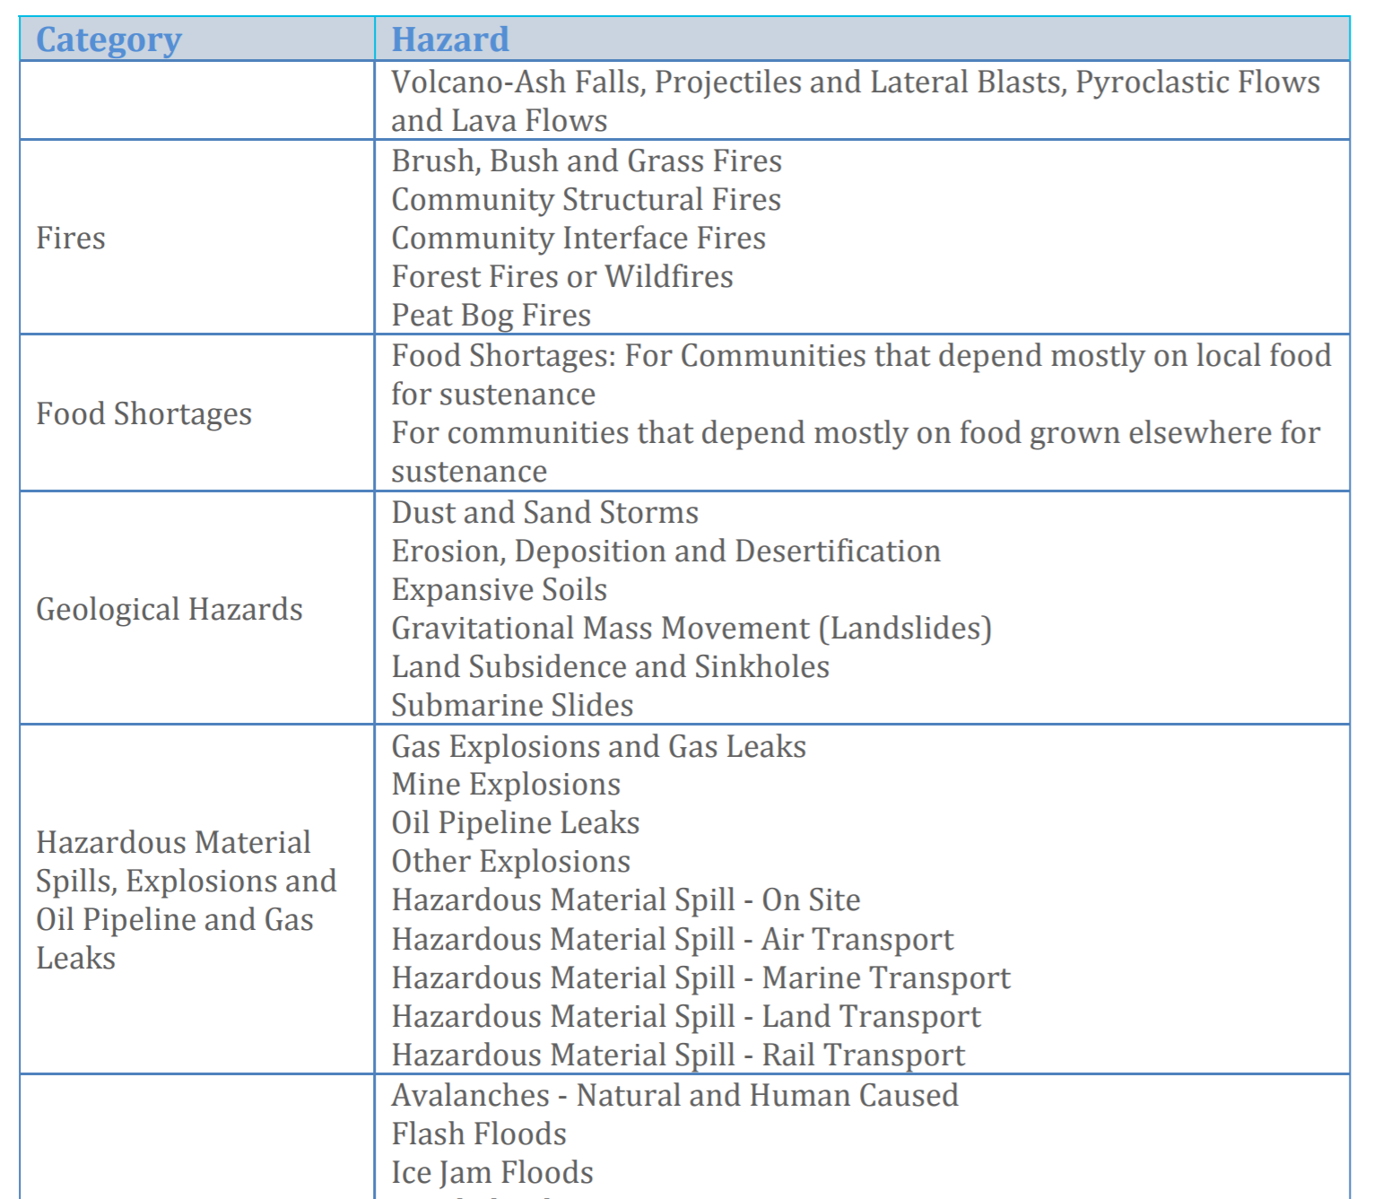
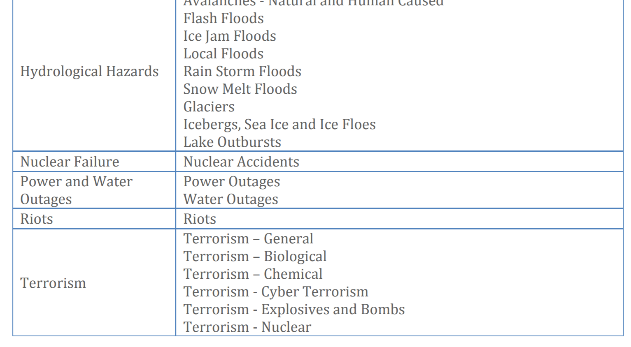
Hazards

Slide 15
Risk
Risk = Hazard x exposure

Slide 16
Risk
Risk = Hazard x exposure + outrage!

Slide 17
Vulnerability
“The use of the concept of vulnerability in Indigenous communities carries added meaning given the historical context of colonisation and the processes that have taken place in settler societies, such as the forced removal of Indigenous individuals and communities from their land and state-condoned efforts to assimilate Indigenous communities.” (p. 3).
Dr. Heidi Ellemor (2005)

Slide 18
Vulnerability
“Emergency management has historically been inﬂuenced by civil defence with ‘command-and-control’, hierarchical models of relating to the community. These models provided a barrier to community involvement in emergency management and were not sensitive to the cultural contexts of indigenous communities.”

Slide 19
Vulnerability
So, we’re vulnerable’?

Slide 20
The 4 R model
Resilience

Slide 21
The 4 R model
Resilience

Slide 22
The 4 R model
Resilience

Slide 23
The 4 R model
Resilience

Slide 24
this ‘resilience’ thing …
“Indigenous concepts of resilience are grounded in cultural values that have persisted despite profound changes in the nature of community life.”
Kirmayer et al. (2012)

Slide 25
What else do I know about disasters?
“Every disaster is a story teller.”
Dr. Victor Okorie
https://indigenousknowledgenetwork.org/what-we-do/

Slide 26
Past Pandemics
Source: Nicolas LePan
https://www.visualcapitalist.com/history-of-pandemics-deadliest/

Slide 27
Past Pandemics
Source: Nicolas LePan
https://www.visualcapitalist.com/history-of-pandemics-deadliest/

Slide 28
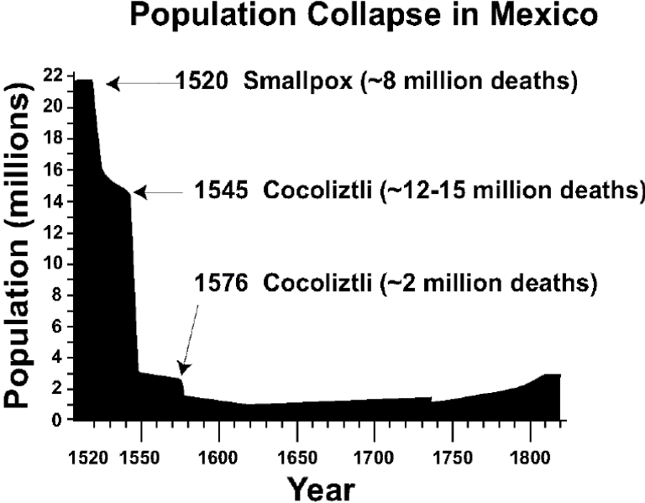
Past Pandemics
The Americas

Slide 29
Past Pandemics
Canada
H1N1: two waves
Inuit were over-represented during first wave
First Nations overrepresented during second wave
Métis were consistently underrepresented in both waves
[National Collaborating Centre for Aboriginal. (2016). The 2009 H1N1 influenza pandemic among First Nations, Inuit and Métis peoples in Canada: Epidemiology and gaps in knowledge. Retrieved from Prince George, B.C.]

Slide 30
H1N1 in Canada
Strong association between severe manifestations of H1N1 and geographic isolation.
Manitoba and Nunavut most severely impacted during the first wave.
Manitoba had youngest and poorest reserve populations which likely made them more vulnerable to H1N1 spread.

Slide 31
H1N1 in Canada
During second wave, most hospital admissions came from other provinces, particularly Alberta.
Quebec reported the most hospital admissions
Ontario reported the most deaths.
Different levels of preparedness within communities and provinces and development of herd immunity within particular places likely contributed to differences between the two waves.

Slide 32
H1N1 in Canada
Indigenous women accounted for:
16% of hospitalized cases
18% of ICU cases
50% of fatalities attributed to H1N1 influenza of those reporting ethnicity across Canada when both waves of the pandemic were combined.

Slide 33
H1N1 in Canada
“There is general consensus that Indigenous peoples were especially vulnerable to severe manifestations of H1N1 influenza.”

Slide 34
What’s going on in Saskatchewan?
Source: https://www.cbc.ca/news/canada/saskatchewan/covid-sask-april-8-1.5526634

Slide 35
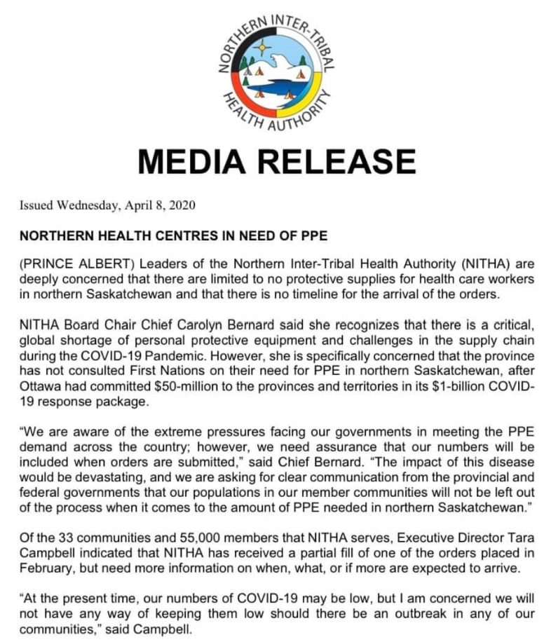
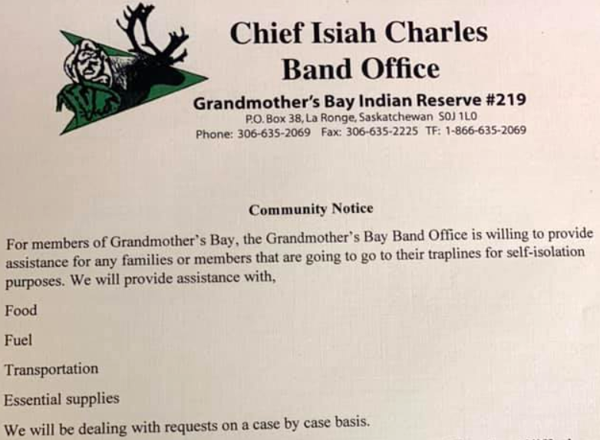
What’s going on in Saskatchewan?

Slide 36
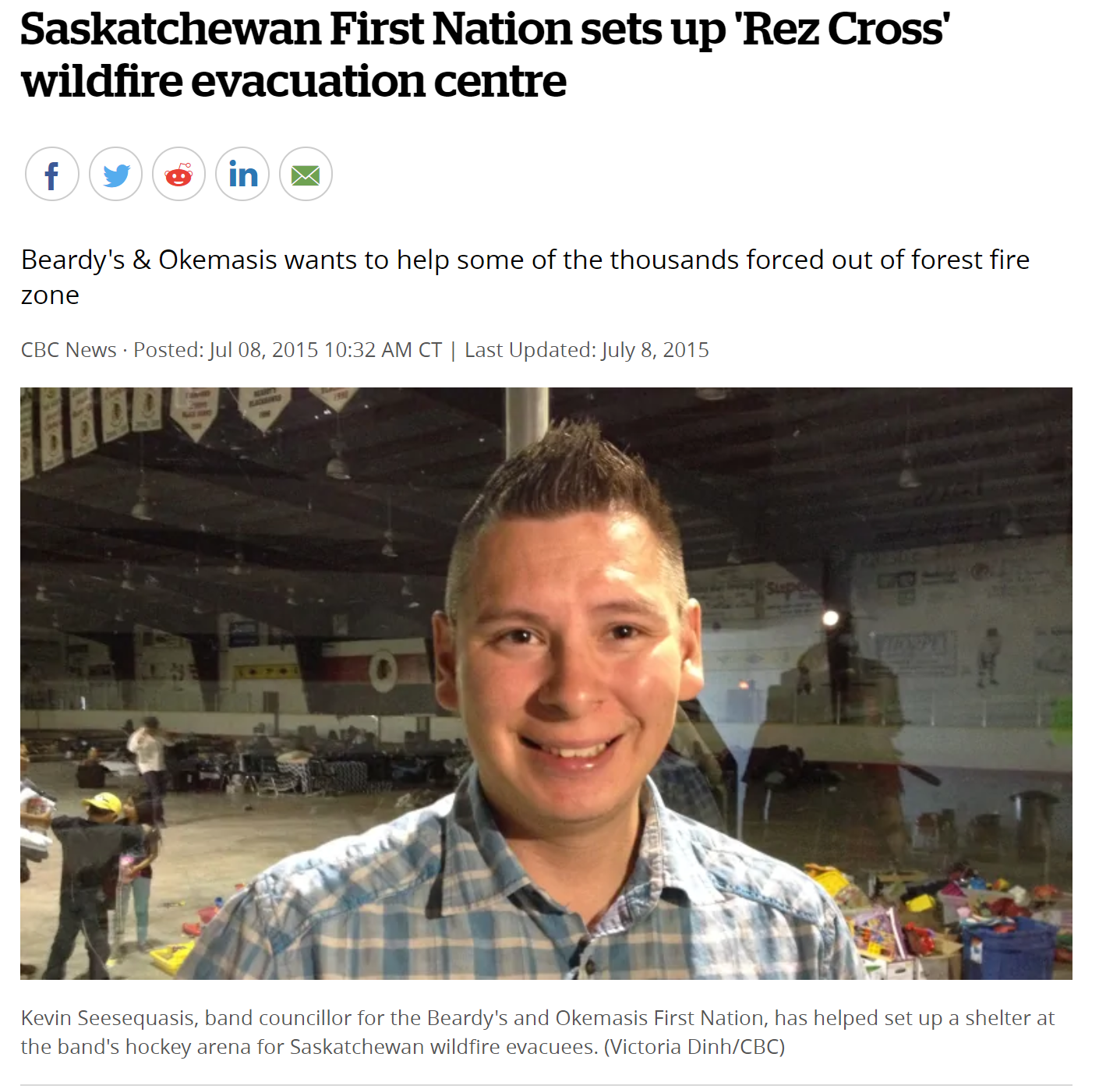
Indigenous EM in SK
ERCs established by Red Cross in Regina, Saskatoon, Prince Albert, North Battleford and Cold Lake, AB.
Several FNs took in evacuees (Ahtahkakoop Cree Nation, Beardy and Okemasis, Willow Cree Nation, James Smith Cree Nation, Muskeg Lake Cree Nation, and Meadow Lake Cree Nation).
The ‘Rez Cross’!

Slide 37
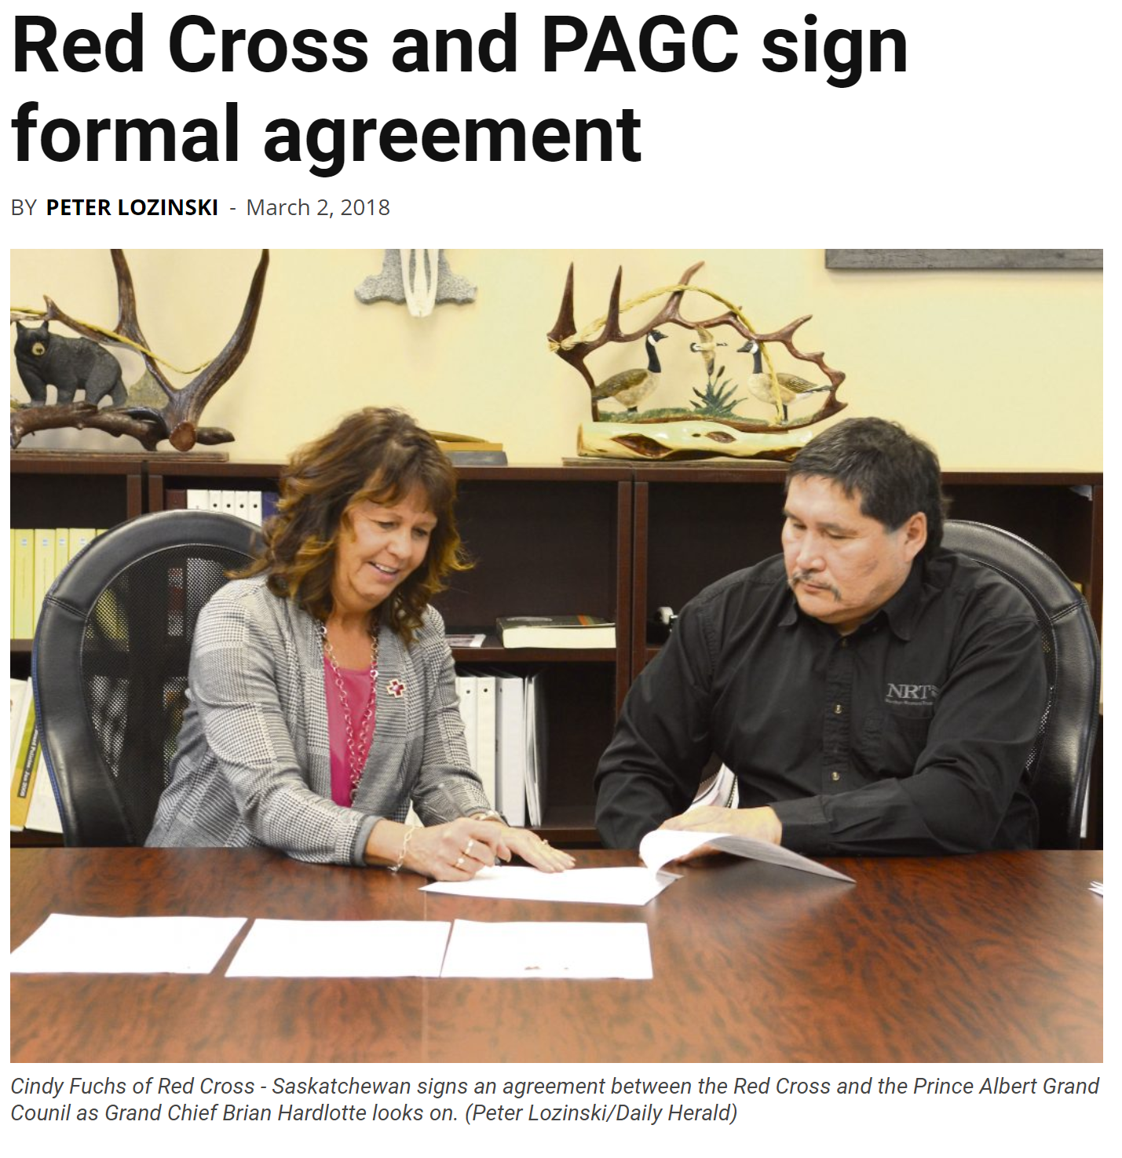
Indigenous EM in SK
Prince Albert Grand Council (PAGC), and the Saskatchewan Red Cross signed an historic agreement to collaborate on future evacuations

Slide 38
Indigenous EM in SK
Indigenous communities have knowledge of their physical and social environment.
This knowledge can reduce the risk of disasters. However, this knowledge is often ignored.
These communities are also recovering from the long-term impacts of colonization and experience ongoing marginalization.
Despite this racism, in Canada Indigenous individuals and communities continue to play important roles in emergency management

Slide 39
Overlapping disasters phases
Indigenous communities are simultaneously responding to, and recovering from, multiple disasters and emergencies.
Reducing risk and readying for the next disaster is difficult, if not impossible.

Slide 40
Indigenous Response Recovery
Indigenous Peoples can provide strategic direction and values-based recoveries.

Slide 41
Research Challenges
What is it about disaster research that distinguishes it from other research?
‘the circumstances in which otherwise conventional methods are employed’ (Stallings 2002: 21).
lack of time to properly develop research instruments
wider societal context of confusion over which projects or processes should be prioritized.
working as an isolated individual is difficult and lacking something fundamental to the human experience.

Slide 42
Research Challenges
Regrettably, all research with Indigenous Peoples takes place in a response/recovery context.
Trauma
Exhaustion (for all participants but especially community-based researchers)
Frustration (things never seem to get better!)
Reliance on colonial structures (funding, evaluation)
But we have the advantage of recognizing and developing the necessary skills to continue the work.

Slide 43
And what?
What is the story of this disaster?
Can it end happily ever after?

Slide 44
Kia ora!

