Slide 1
Developing and writing a successful research grant in partnership with Métis and First Nations community partners Dr. Caroline Tait, PhD Saskatchewan Indigenous Mentorship Network Saskatchewan First Nations and Métis Health Research Network April 3, 2020

Slide 2
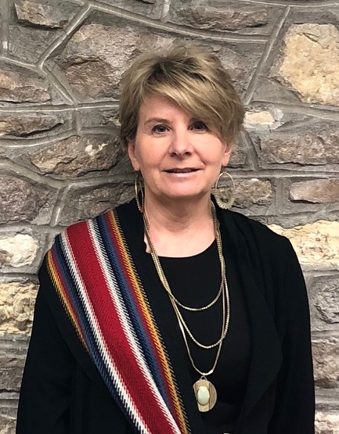
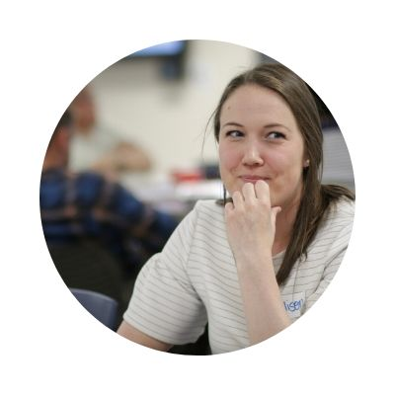
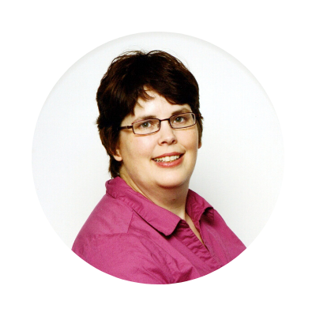
Facilitator: Dr. Caroline Tait
Fleur Macqueen Smith
Rhonda Taillon
Allison Piché

Slide 3
Key considerations prior to starting your grant application
Identification of funding opportunity
Ongoing discussions with existing or potential Indigenous community partners about their research priorities
Present new funding opportunities to your community partners
Decide on a funding opportunity that fits with the research priorities of your community partners and your research expertise
The funding call should be a call that you believe you have a reasonable chance of being successful

Slide 4
Putting together your research team
Work with your community partners to decide if other communities, organizations or stakeholders should be included
Pull together your research team. Generally your team should include at least one of the following individuals:
a. community lead,
b. senior researcher,
c. new investigator,
d. knowledge user such as a representative from the health authority, front line organizations etc.

Slide 5
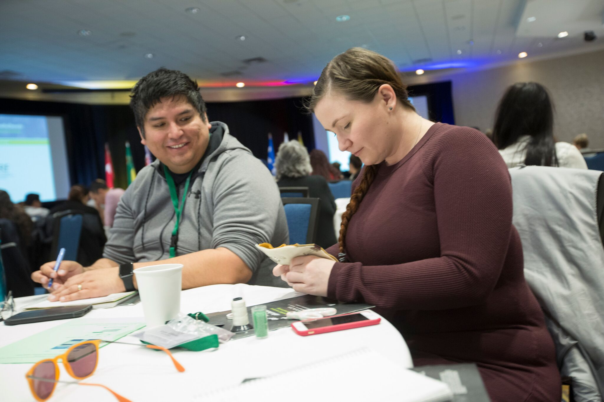
Putting together your research team
Additional people to include:
a. individuals identified by your community partner(s) such as Elders
b. postdoctoral fellows & graduate students
c. researchers who bring complementary methodological and theoretical perspectives
Do not be shy to ask people to be part of your team, and try to build a team that will give the level of commitment to the project that you want

Slide 6
How long does it take to write a successful grant proposal?
Time is the key consideration once your team has determined the funding call that you will apply for.
To write a successful CIHR, SSRHC, or SHRF grant you will need the full time period of the call. This is generally 4-6 months, with some research calls have a two or three phase approach that involves for example, a statement of interest or a letter intent which is peer reviewed, followed by an invitation to submit a full proposal.

Slide 7
How long does it take to write a successful grant proposal?
For student funding, some applications are reviewed internally and advanced through your institutions.
One of the most common mistakes made by research teams is to underestimate the time it takes to prepare a full grant proposal.

Slide 8
How competitive is Tri-agency funding?
The current success rate for grants varies for Tri-agency funding, however for open competitions such as CIHR Project Grants, it is around 20%, with each funded grant needing to score in the fundable range.
In Indigenous health research, illustrating authentic community partnerships is key to success. Reviewers, especially Indigenous reviewers, pay a lot of attention to letters of support from Indigenous partners, the role of Indigenous community partners in the design and in the activities of the grant, and engagement and involvement of Indigenous partners in knowledge translation activities.

Slide 9
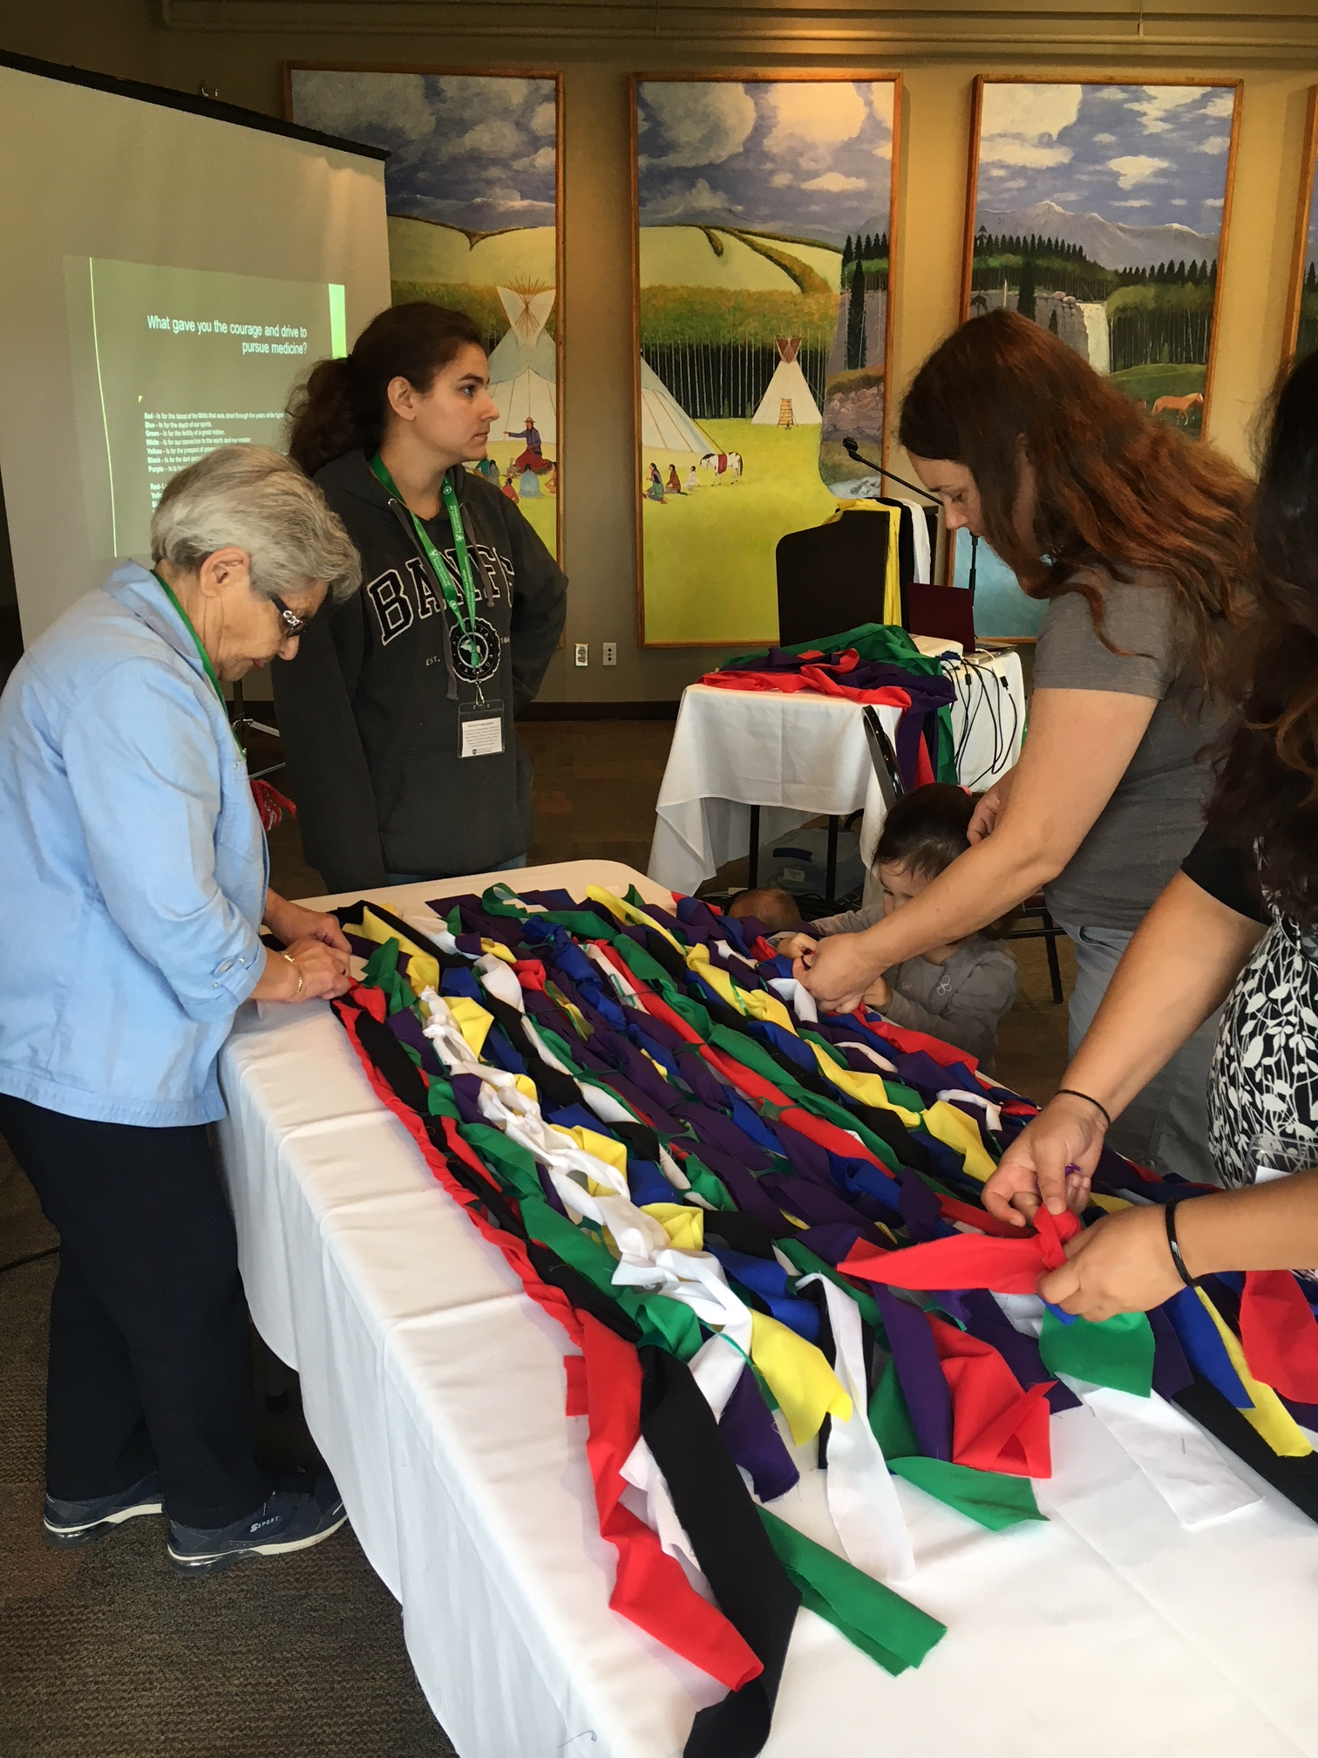
Where to find out about research funding opportunities:
Contact our Network for grant writing support from our Research Facilitators, and to sign up for our newsletter, which will include funding opportunities
Look for funding opportunities online
sign up for any of the USask research listservs (Google “Usask listserv”) for funding announcements, deadlines, and research workshops
Your department/college may also have Research Facilitators who can support you

Slide 10
Common elements in research proposals:
The research proposal itself – usually done in a word processor, and uploaded
Attachments: proposal reference list, diagrams, logic models, governance models
Budget and budget justification
CVs for all team members, often done in the online Common CV system
Letters of support from graduate supervisors, departments, the university, governments, nonprofits, and other organizations you may partner with in your research
Signature pages that may need to be signed by each team member on the proposal, your department, and then the university itself

Slide 11
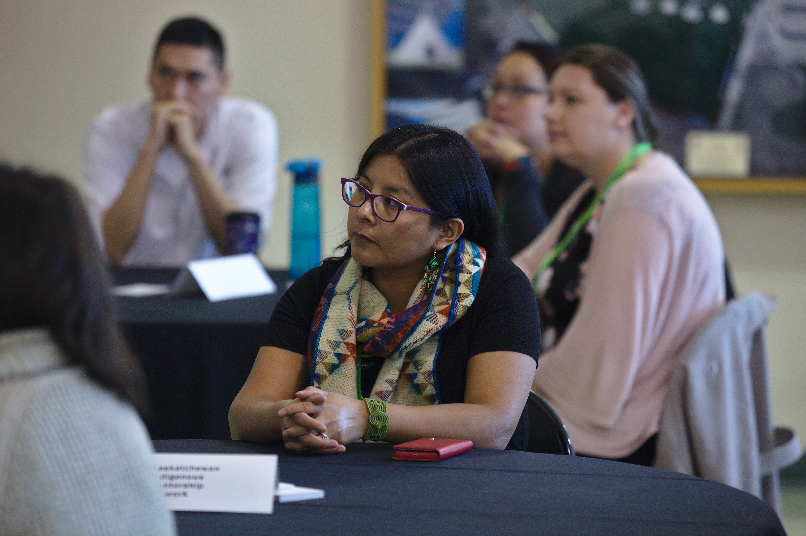
Getting started on an application
Find and download a copy of the application instructions for the grant
Print a copy and keep it close at hand so you can refer to it often
Set up an application in whatever online system is used for submission, and familiarize yourself with the system

Slide 12
CVs and Letters of Support
CVs for all team members, often done in the online Common CV system, which takes time to set up and learn
You may need to do CVs for community partners as well as your own
Letters of support from graduate supervisors, departments, the university, governments, nonprofits, and other organizations you may partner with in your research
Easier to get letters when you send potential supporters a summary of your research, and a draft of a letter customized for them, that they can review and revise

Slide 13
Writing the research proposal
Using the application instructions, create an outline for your proposal, copying the description for each element of the application, and the evaluation criteria for this section of the application, so this is right in front of you as you start to write your proposal

Slide 14
Asking questions, and getting people to review your proposal
Ask for feedback from your team members, supervisors, Research Facilitators (at our First Nations and Métis Health Research Network and/or in your College), your Research Services contact, your peers, and anyone else you think might make time to review your work
Many of these people will be able to provide you with copies of proposals, budgets and budget justifications, letters of support and other proposal pieces that you can use to better understand how to craft a strong proposal
Don’t hesitate to call or email the funder for more information

Slide 15
Required signatures and university approval:
Applications often need signatures from all team members, and from your department, and then from Research Services
Research Services will want your completed proposal five (5) business days ahead of the funding agency deadline

Slide 16
Required signatures and university approval:
Contact USask Research Services (306-966-8576, research.services@usask.ca) to let them know you are applying for something, and find out who your staff contact is there
Set up an online account in the Research Services proposal submission system, UnivRS
Visit Usask’s Office of the Vice-President, Research (https://vpresearch.usask.ca/) for more research information: links to the university Knowledge Base, and information on funding

Slide 17
Most of all –
all of this takes a lot of time so start early

